Slide 1
Locating Refugee Camps in the Democratic Republic of the Congo
Marie Parent
Master in Public Policy, 2018

Slide 2
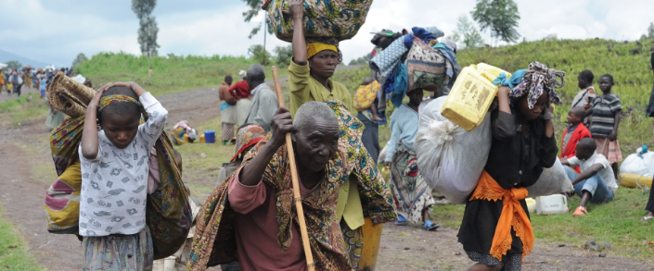
Introduction
The Kivu conflict along the eastern border of the Democratic Republic of the Congo began in 2004 as an armed struggle between Hutu Power rebel forces and the state military. The conflict persists today, involving a fluctuating number of violent actors, becoming increasingly complex with each passing event, and deeply miring the region in an endemic of violence.
The ongoing humanitarian effects of this constantly evolving crisis have been astronomical. The UN Refugee Agency (UNHCR) reports over four hundred thousand refugees and 1.7 million internally displaced persons** (IDPs) living in the DRC. Approximately 878,000 refugees and IDPs, almost half of the total, live in the province of Nord Kivu. This number is greater than the population of San Francisco - all living in a region that is, and has been, the epicenter of conflict for over a decade.
Even once an internally displaced person or refugee has reached a refugee camp, they are far from safe. For example, Mugunga III camp located in Goma, Nord Kivu’s capital, suffered widespread harm from violent actors in December of 2012, including robberies, violence, and rapes.*** Violent groups around refugee camps put a further strain on already overburdened UN peacekeeping forces in the DRC as they struggle to maintain security.
* A refugee is anyone who has fled their home and moved outside of their home country’s borders. Refugees in this case are primarily people from countries bordering the DRC who have fled into the DRC.
** An internally displaced person (IDP) is anyone who has fled their home but remains in their home country.
***http://www.unhcr.org/en-us/news/latest/2012/12/50d049206/unhcr-still-concerned-security-situation-camps-near-goma.html

Slide 3
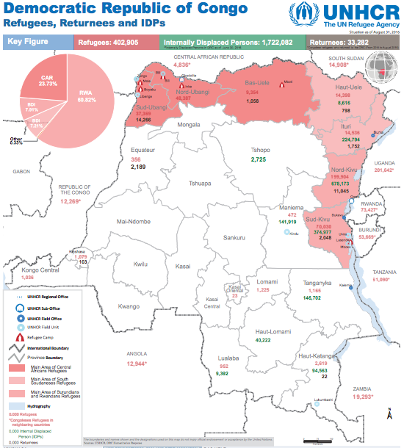
As the number of IDPs and refugees multiplies both in the DRC and globally, the UNHCR and other refugee agencies will need to think carefully about where to establish new camps. Locations like Goma are close to city infrastructure and refugee agencies’ headquarters, minimizing the resources needed to maintain the camp. However, the convenience often comes at the cost of camp residents’ health and safety. In some cases, it might be ideal to locate or relocate camps farther violence-prone areas that have historically housed refugees in order to ensure that inhabitants are reasonably safe.
With this in mind, I have examined historical violence in the Democratic Republic of the Congo, with a focus on Nord Kivu, to determine where future refugee camps might best be located. Additionally, I have created an algorithm that allows the user to calculate the distance from historically violent locations to potential refugee camp locations, in order to ensure that camps are sufficiently distanced from security risks.
Source: UNHCR
file:///Users/marieparent/Downloads/DRC_Factsheet_August_3W_2016_A3P.pdf

Slide 4
Methodology
Examination of Conflict Data for the DRC
The data sources I examined include the following:
ACLED Version 6
A disaggregated dataset in csv and shapefile format of conflict events in Africa from 1994 to 2015. Event attributes include date, number of fatalities, location, and event type. In addition to filtering the data by country, I filtered by years 2006 to 2015, choosing a time period that covers most of the Kivu conflict while still remaining a recent and intuitive timeframe.
Initially, I was interested in examining locations and the number of fatalities from this dataset, however, these two attributes are not precise enough to stand up to rigorous analysis. For example, fatalities are recorded as ‘12’ if ‘dozens’ of fatalities are reported, and ‘100’ if ‘hundreds’ are reported. Locations are given as the nearest city or town, such that each event does not have a unique location.
Digital Chart of the World Road Network
Shapefiles with countries’ road networks.
Global Administrative Areas - Country- and Province-Level Datasets
Shapefiles with country outlines and administrative subdivisions. I used the 2015 version with Adm0- and Adm2-level data to obtain the country outline and the outline for the province of Nord Kivu.
ETH Zürich’s Geo-Referenced Ethnic Power Relations Dataset
I was interested in examining how areas in the intersection ethnic group polygons or at the border of ethnic group polygons might be more conflict-prone than other areas. I filtered this data by country and year active (i.e., in this case up until 2013). However, an overlay of ACLED observations on the ethnic group polygons did not suggest a relationship that could be explained by the polygons alone. Furthermore, some polygons in the dataset were improperly recorded and therefore unusable. Although none of these were in the DRC, it made me skeptical of the data’s overall quality.
Cities
Using Wikipedia’s population and geolocation data, I hand-coded the top 30 most populous cities in the DRC as well as each province’s capital city. However, a brief examination of conflict data by event type did not suggest patterns between different kinds of cities, other than the national capital having far more riots and protests. Furthermore, analysis of event types by types of cities would be less generalizable and challenging than a distance-calculating algorithm, so I did not pursue that path.

Slide 5
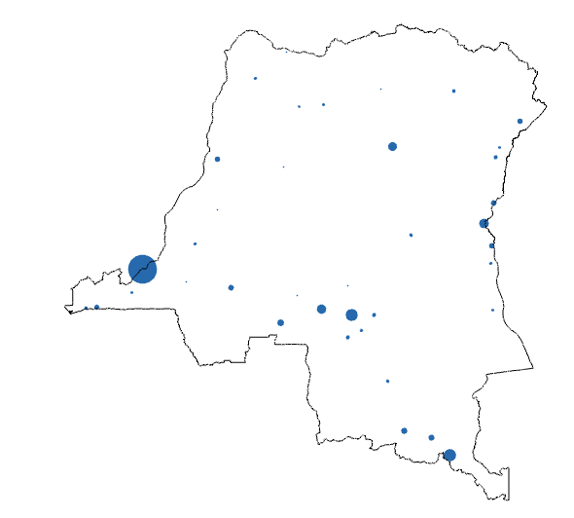
Discussion of Distance Measurement
I considered converting degree measurements to kilometers in order to account for the distortion in distance calculations caused by longitudinal measures. Comparing a point on the equator, which passes through the DRC, to a point in the southernmost part of DRC, farthest from the equator, longitudinal measurements would only be distorted about 2.74%, or about 3.04 kilometers per degree. This distortion is small enough relative to the overall precision of the datasets that I worked with that it would not be useful to account for it.
Aggregating ACLED Data by Location
In plotting conflicts from the disaggregated ACLED dataset, conflicts with the same geographical coordinates are plotted over each other. Therefore, the resulting map provides no information about the number of conflicts at a particular location. Similarly, if one plots each conflict scaled by fatalities, the scale of the conflict resulting in the most fatalities is evident, but no information about any other conflicts is visible.
To make the data more useful, I decided to aggregate the data by location. With the help of the countmember function* from Matlab Central’s file exchange, I created counts of data at each location over the 2006 to 2015 time period in the following forms:
Count of events
Count of events by event type
Count of fatalities
Count of fatalities by event type
Count of protest/riot events by protest/riot
For the protest/riot counts, I built my filter based on identified actors (Actor1 or Actor2) who were Democratic Republic of the Congo rioters or protesters. I purposefully excluded 21 events that were not by DRC protesters or rioters from the analysis. I also chose to includes 24 events that are Event_Type = 'Violence against civilians,' rather than 'Riots/Protests,' that involved the aforementioned actors.
Kinshasa
* https://www.mathworks.com/matlabcentral/fileexchange/7738-countmember-a-b-

Slide 6
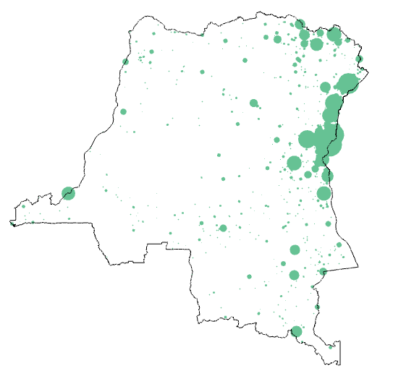
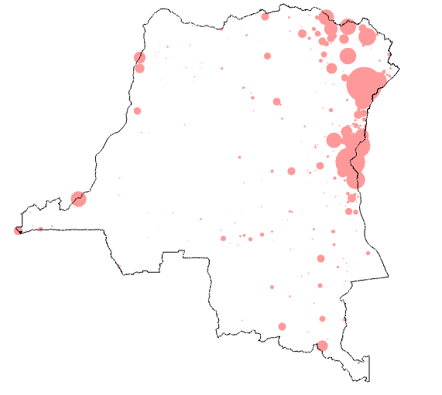
Analysis & Results
Overview of the DRC’s Conflict Patterns
Number of Conflicts in the DRC, 2006-2015
Conflict Fatalities in the DRC, 2006-2015
A quick look at the number of conflicts reveals that most conflicts happen around the borders of the Democratic Republic of the Congo, rather than inland. In particular, the eastern and northeastern borders have high rates of conflict.
Overwhelmingly, conflict fatalities from 2006 to 2015 occur where the DRC shares a border with Uganda, Rwanda, and Burundi. This is the area in which violent actors involved in the Kivu conflict are most concentrated and active.

Slide 7
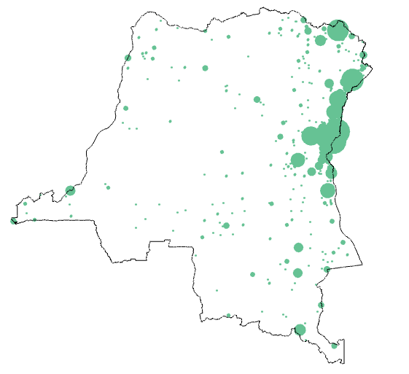
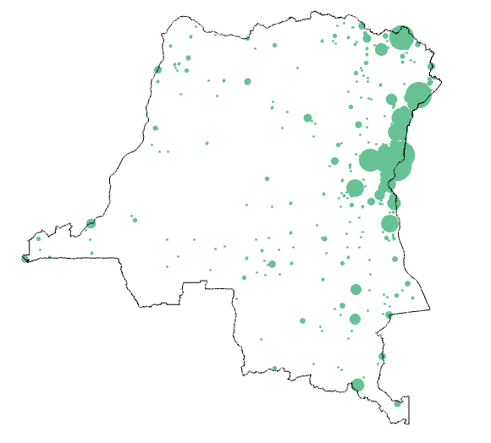
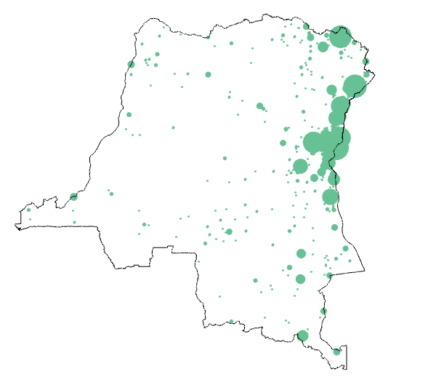
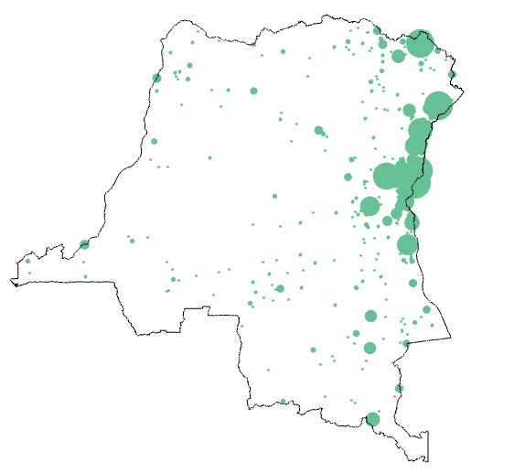
Battle - No Change of Territory
Battle - Non-State Actor Overtakes Territory
Battle - Government Regains Territory
Headquarters or Base Established
These events all follow a similar pattern, occurring most prevalently where the DRC shares a border with South Sudan, Uganda, Rwanda, and Burundi. Unsurprisingly, there are not many of these events in the capital city of Kinshasa.

Slide 8
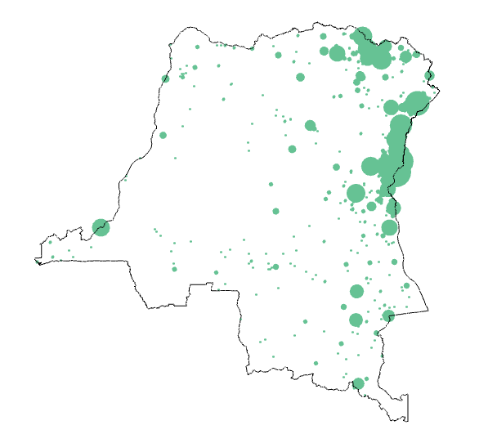
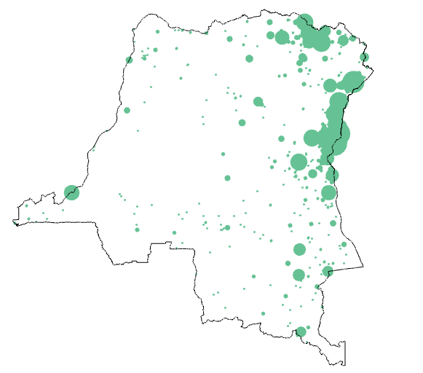
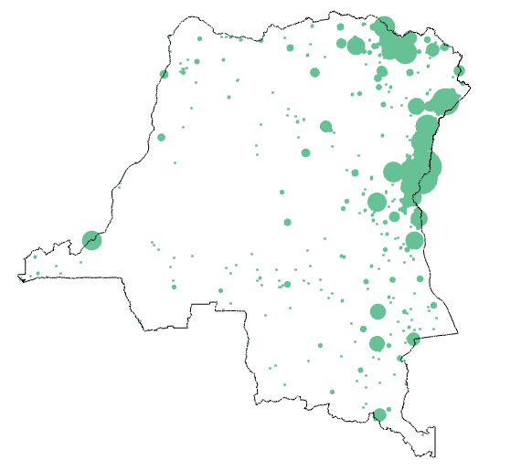
Remote Violence
Non-Violent Transfer of Territory
Violence Against Civilians
All three of these event types follow a similar geographical pattern. While still concentrated most along the northeast and eastern boarder, these events are more likely to break out in the center of the country and in the capital city of Kinshasa than battles.

Slide 9
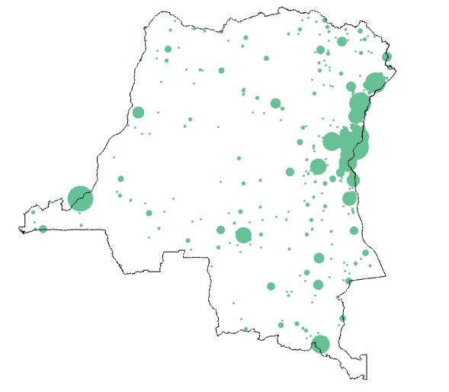
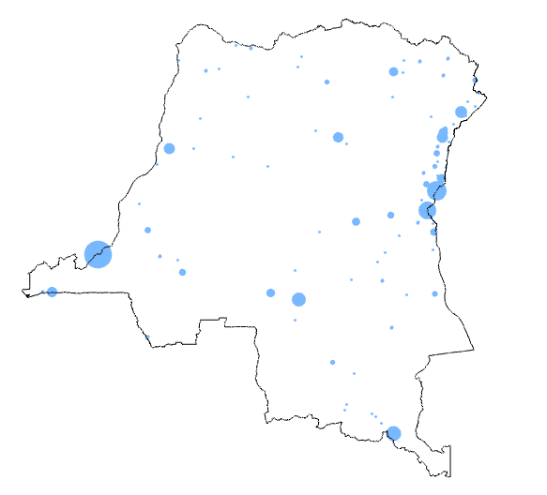
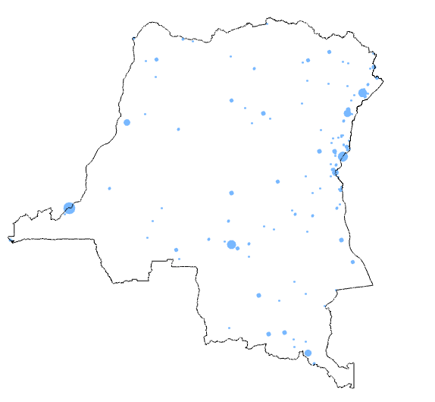
Riots & Protests
Protests
Riots
Unsurprisingly, protests and riots are relatively much more likely to occur in the capital city of Kinshasa than are other kinds of conflict events. They are also relatively more prevalent in the country’s second most populous city, Lubumbashi, located in the south. Protests, which are nonviolent, are more common than riots.

Slide 10
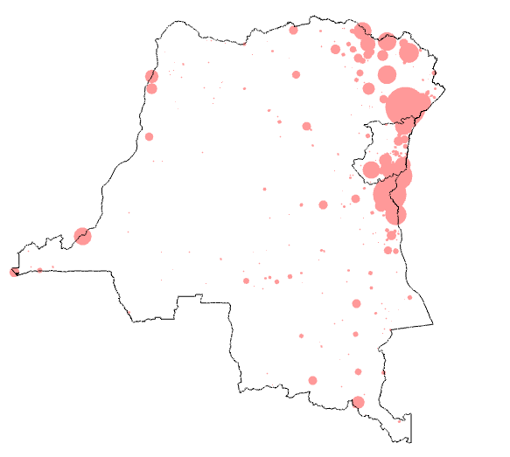
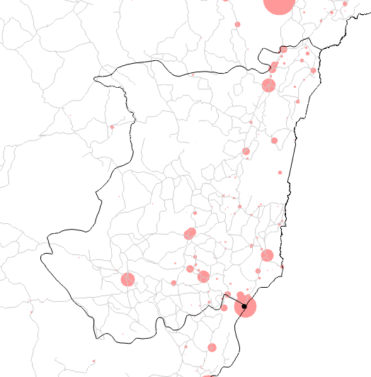
Analysis & Results
Overview of the DRC’s Conflict Patterns
Nord Kivu
Democratic Republic of the Congo
Fatalities in Nord Kivu are primarily in the southeastern half of the country, with the most being concentrated in the province’s capital, Goma. We can see that conflicts also tend to occur along roads, especially where roads intersect.
Goma
Nord Kivu

Slide 11
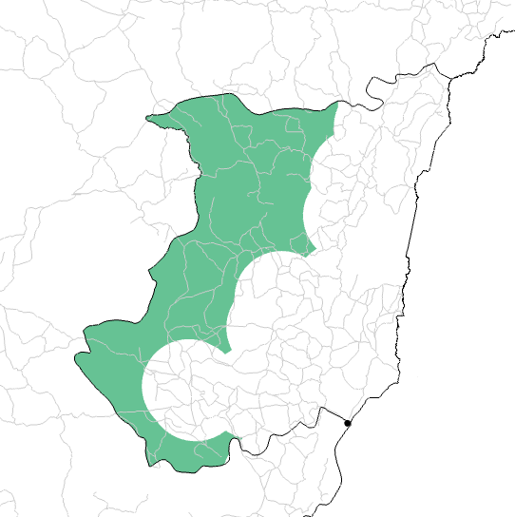
Analysis & Results
Overview of the DRC’s Conflict Patterns
When thinking about where to locate a refugee camp, we might consider that a camp should be accessible to refugees and have access to necessary resources but also that it should not be located in an area where we expect violence to break out. Using data from 2006 to 2015 as a predictor of violence, I screened out areas around the recorded conflict locations that are likely to be dangerous in future as well. The parameters I used, which could be adjusted, are as follows:
Radius of .35 degrees, which is about 39 kilometers and about 8 hours at a slow pace on foot.
Avoid any locations that have had more than 4 conflicts and 20 fatalities in the 2006-2015 time frame.
While this buffer method can provide a quick-and-dirty visualization of safe zones, it is limited. Likely, we would like to locate a refugee camp either on or near a road. Furthermore, potential threats would also travel along roads. For this reason, it is more useful to know the distance along the road network to likely conflict locations.
“Safe Zone”

Slide 12
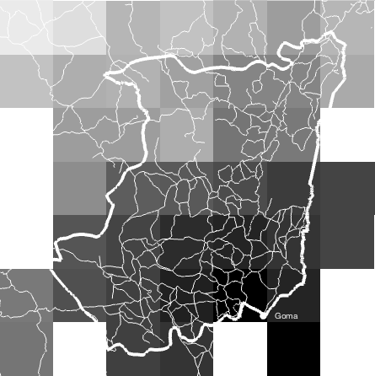
Analysis & Results
Overview of the DRC’s Conflict Patterns
Using Dijkstra’s Algorithm, I wrote a script that calculates the distance from any possible refugee camp in the Nord Kivu area at a given resolution to conflict locations. This distance can be broken down into two parts. First, the distance from the possible refugee camp location to the road is calculated as a straight path using the p_poly_dist function obtained from Matlab Central’s file exchange (author: Michael Yoshpe). The assumption here is that, if a refugee camp were built away from a major road, the path that would need to be cleared to the existing road would be relatively straight. Second, the distance along the road network is calculated using the functions RoadDist and MinNodeDist (Dijkstra’s Algorithm).
Distances along Roads to Camp Locations
The heatmap above shows the distances from camp locations to Goma, which is notoriously dangerous, with “safer” camp locations in a lighter shade. The algorithm is set up so that someone with better computing equipment could (1) create a heatmap that shows the distances from camp locations to an entire set of historically violent locations and (2) calculate the heatmap at a higher resolution by changing the variable “delta” in the script. I have not actually run these calculations myself. I estimated that it would take my computer about 16 days to compute the heatmap matrix from any camp location to all historically violent locations, even at a resolution of just delta = .5 degrees. Ideally, the MinNodeDist function would be streamlined to reduce processing time.

